Slide 1
Unit 4

Slide 2
Outline
Reading Summary
Definition
Formula
Unit 4 Self-Quiz : Videos Explanation

Slide 3
Summary
Variability in the data come from the fact that different subjects in the sample may obtain different values for the measurement
A frequency table, a table of relative frequency, or the cumulative relative frequency can be used to summarized the variability in the data
The bar plot, the histogram, or the box plot may be used to provide a graphical display of the variability in the data
The main features that characterize the variability in the data are: the location of the distribution; and the spread of the data
The mean and the median are used to identify the location of the distribution
The spread of the data are quantified by the sample variance, standard deviation and the interquartile range

Slide 4
Summary
There are two form of variability not directly associated with the data: the population variability; and the random variable variability.
The variability of the population differ from the variability of the data in that it corresponds to the variability of the quantity of interest across all members of the population and not only for those that were selected to the sample
The aim of the variability of the random variable is to model the notion of randomness in measurements or the uncertainty regarding the outcome of a measurement.
The variability of a random variable is usually considered in the context of selecting one subject at random from the population.

Slide 5


Summary
It is crucial to understand the following: The variability of the data relates to a concrete list of data values presented to us. Meanwhile, the variability of the population and of the random variables are not associated with quantities we actually get to observe.
A characteristic of the distribution of an entire population is called a parameter. Example of the population parameters are the population mean ( ) and the population standard deviation ( ).
A random variable is the future outcome of a measurement, before the measurement is taken. It is a collection of potential values with a distribution over these values.
After the measurement is taken and the specific value is revealed then the random variable ceases to be a random variable! Instead, it becomes data.

Slide 6
Summary
In the context of random variable, the relative frequency is known as the likelihood probability.
More formally, a random variable refer to numerical values such as: the outcome of an observation, or a measurement, or a function
A random variable is characterized by two elements: the sample space (the collection of potential values the random variable may take) and the probability (the likelihood of obtaining each of the values in the sample space)
The probability function of a random variable is defined for any value that the random variable may obtain and produces the distribution of the random variable. The probability function may emerge as a relative frequency since they both define a distribution

Slide 7
Summary
Just like the data and the population, the distribution of a random variable is characterised by its center and its spread.
The center of the distribution of the random variable is called the Expectation. As you will see in the subsequent slide, the formula for the expectation is similar to that of the mean. The only difference is that the probability function can be viewed as the relative frequency
The spread of the distribution of a random variable is called the variance.

Slide 8
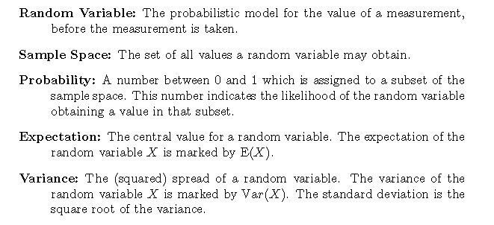
Definition

Slide 9
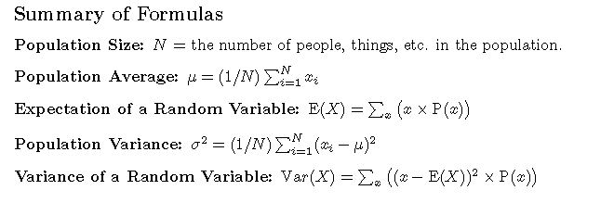
Formula

Slide 10
Unit 4 Self-Quiz : Videos Explanation
https://youtu.be/HugWpB6Coz8
https://youtu.be/Z4NGIXDVFEM
https://youtu.be/mv4kPiscICo

